Slide 1
PIC18F4520
Lab9 - CCP Module and Motor
Yu-Syuan Liu
劉宇軒

Slide 2
LAB
Please use the PWM related formula, the CCP module control register, the PWM related register, and the Timer knowledge learned last week, to adjust the required PWM Period for this Tower Pro SG90 servo motor and continuously change the Duty Cycle.
Use the button to control the rotation:
  The starting position is +90 degrees.
  When pressing the button, the rotation angle +90 -> 0 -> -90.
Demo tips: (You can write either C or Assembly code.)
    Need to tell the TA how to set the PWM Period, what’s the cycle time.
    Need to tell the TA what are the values of PR2 register and CCP1CON<5:4> while at +90, 0, -90 degrees.

Slide 3

PWM Period Formula
The PWM period is specified by writing to the PR2 register

Slide 4
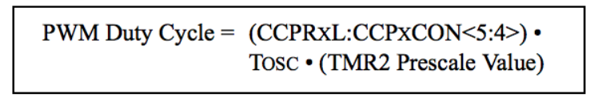
PWM Duty Cycle Formula
The PWM duty cycle is specified by writing to the CCPRxL register and to the CCPxCON<5:4> bits. Up to 10-bit resolution is available

Slide 5
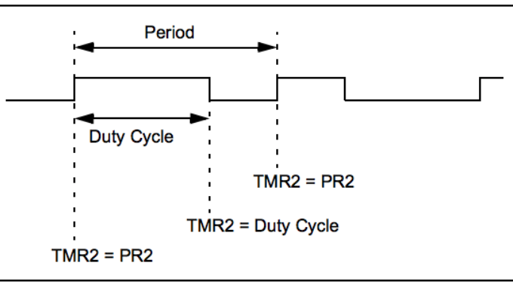

Slide 6
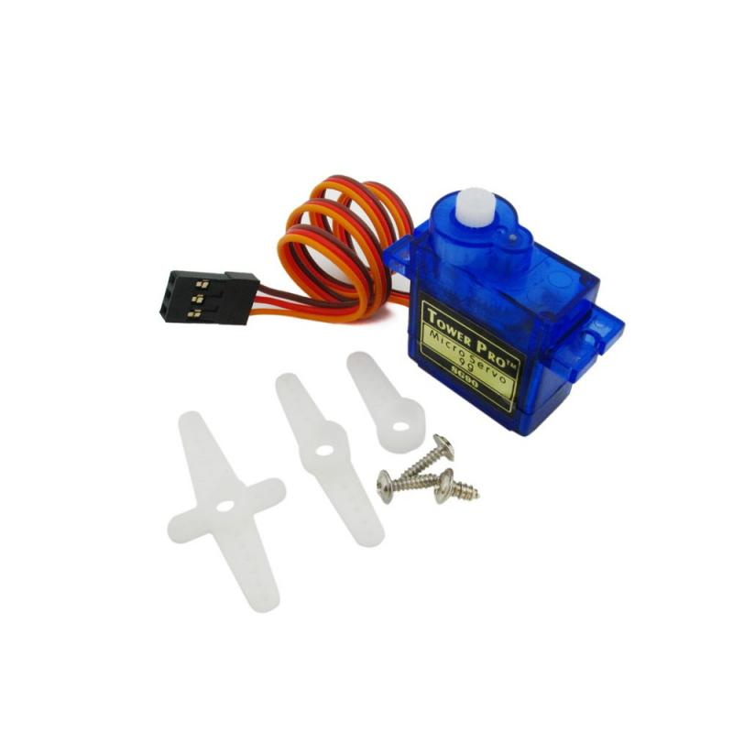

Tower Pro SG90
Servo motor

Slide 7
重量：9g
尺寸：23*12.2*29mm
工作電壓：4.8V
轉矩：1.8kg-cm，當工作電壓為4.8V時
運轉速度：0.1秒 ∕ 60度 ，當工作電壓為4.8V時
訊號脈波設定：50Hz (即20ms)
脈衝寬度範圍：500~2400µs (1500µs 為0度)
死頻帶寬度（dead band width）：10µs

Slide 8
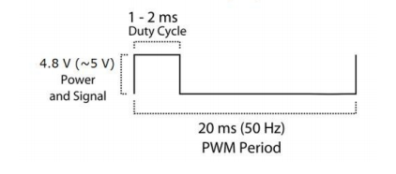
示意圖

